Slide 1
Assembler Design Options

Slide 2
One and Multi-Pass Assembler
So far, we have discussed the design and implementation of a two-pass assembler.
Here, we will present the design and implementation of
  One-pass assembler
    Used if avoiding a second pass over the source program is necessary or desirable.
  Multi-pass assembler
    An extension of 2-pass logic that allow forward references during symbol definition.

Slide 3
One-Pass Assembler
The main problem is about forward reference.
Eliminating forward reference to data items can be easily done.
  Simply ask the programmer to define variables before using them.
However, eliminating forward reference to labels on instructions cannot be easily done.
  Sometimes, program logic require a forward jump.
  Eliminating all forward jumps would be too restrictive and inconvenient.

Slide 4
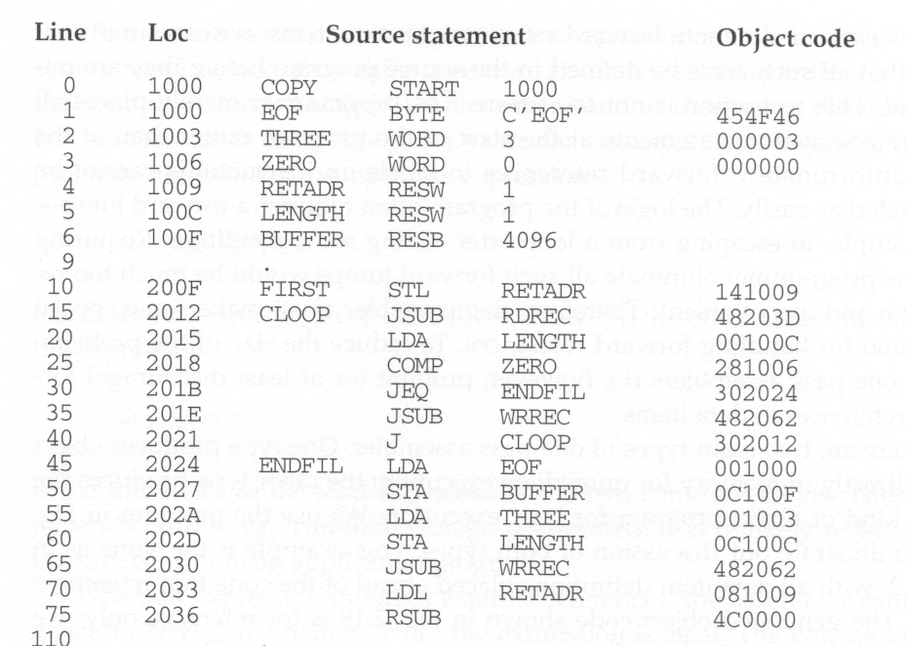
Program Example

Slide 5
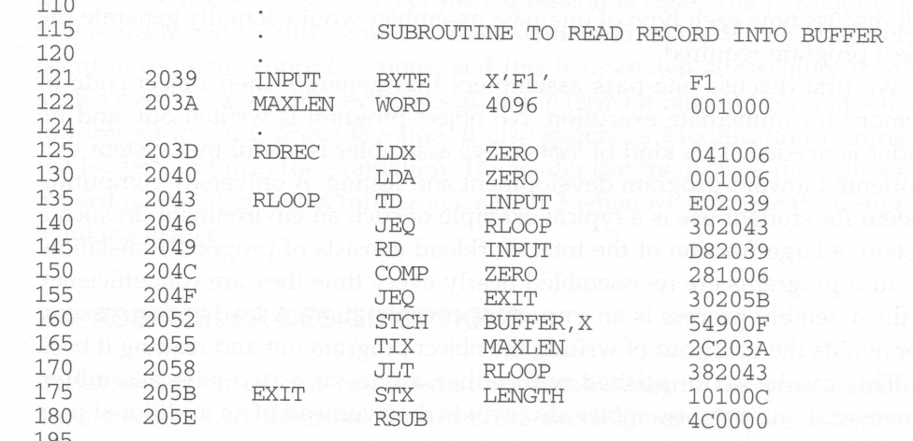

Slide 6
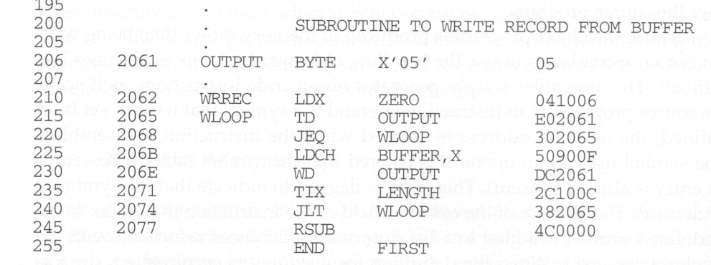
All variables are defined before they are used.

Slide 7
One pass assembler -Two Types
  1) Produce object code directly in memory for immediate execution
    No object program is written out and No loader is needed.
    Load-and-go assembler - useful in program development and testing environments.
    Good for computing center where most students reassemble their programs each time.
    Efficiency of assembly process is important.
    A load-and-go assembler avoids the overhead of writing the object program out and reading it again.
    Can save time for scanning the source code again.
  2) Produce the usual kind of object program for later execution

Slide 8
Internal Implementation
The assembler generate object code instructions as it scans the source program.
If an instruction operand is a symbol that has not yet been defined, the operand address is omitted when the instruction is assembled.
The symbol used as an operand is entered into the symbol table.
This entry is flagged to indicate that the symbol is undefined yet.

Slide 9
Internal Implementation (cont’d)
The address of the operand field of the instruction that refers to the undefined symbol is added to a list of forward references associated with the symbol table entry.
When the definition of the symbol is encountered, the forward reference list for that symbol is scanned, and the proper address is inserted into any instruction previously generated.

Slide 10
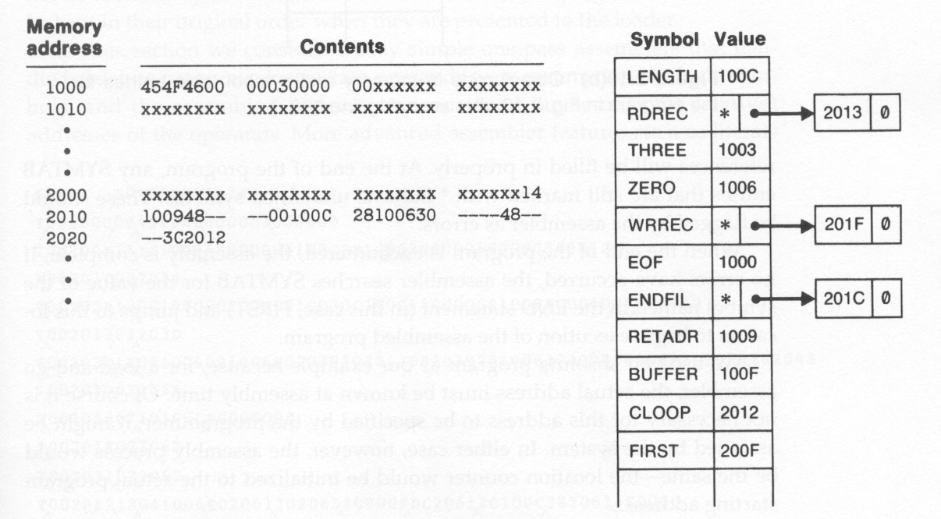
Processing Example
After scanning line 40

Slide 11
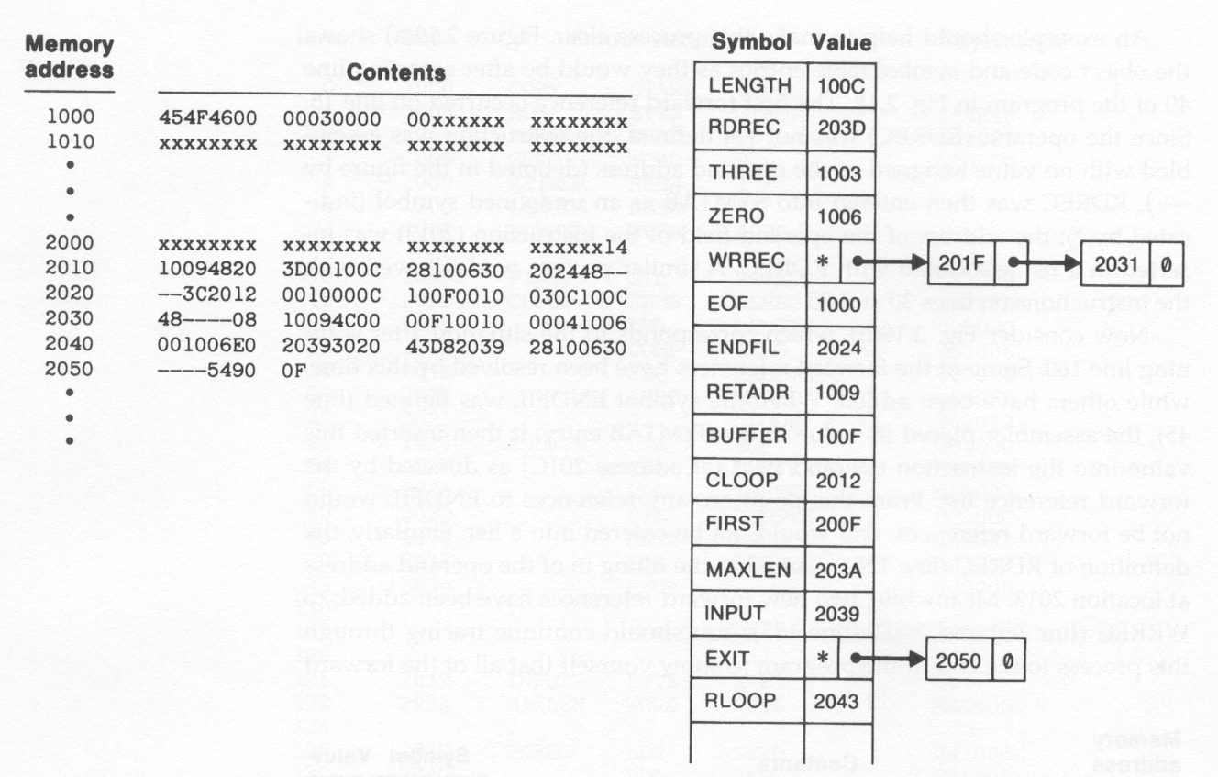
Processing Example (cont’d)
After scanning line 160

Slide 12
Processing Example (cont’d)
Between scanning line 40 and 160:
  On line 45, when the symbol ENDFIL is defined, the assembler places its value in the SYMTAB entry.
  The assembler then inserts this value into the instruction operand field (at address 201C).
  From this point on, any references to ENDFIL would not be forward references and would not be entered into a list.
At the end of the processing of the program, any SYMTAB entries that are still marked with * indicate undefined symbols.
  These should be flagged by the assembler as errors.

Slide 13
One-Pass Assembler that
Produce Object Programs
If the operand contains an undefined symbol, use 0 as the address and write the Text record to the object program.
Forward references are entered into lists as in the load-and-go assembler.
When the definition of a symbol is encountered, the assembler generates another Text record with the correct operand address of each entry in the reference list.
When loaded, the incorrect address 0 will be updated by the latter Text record containing the symbol definition.

Slide 14
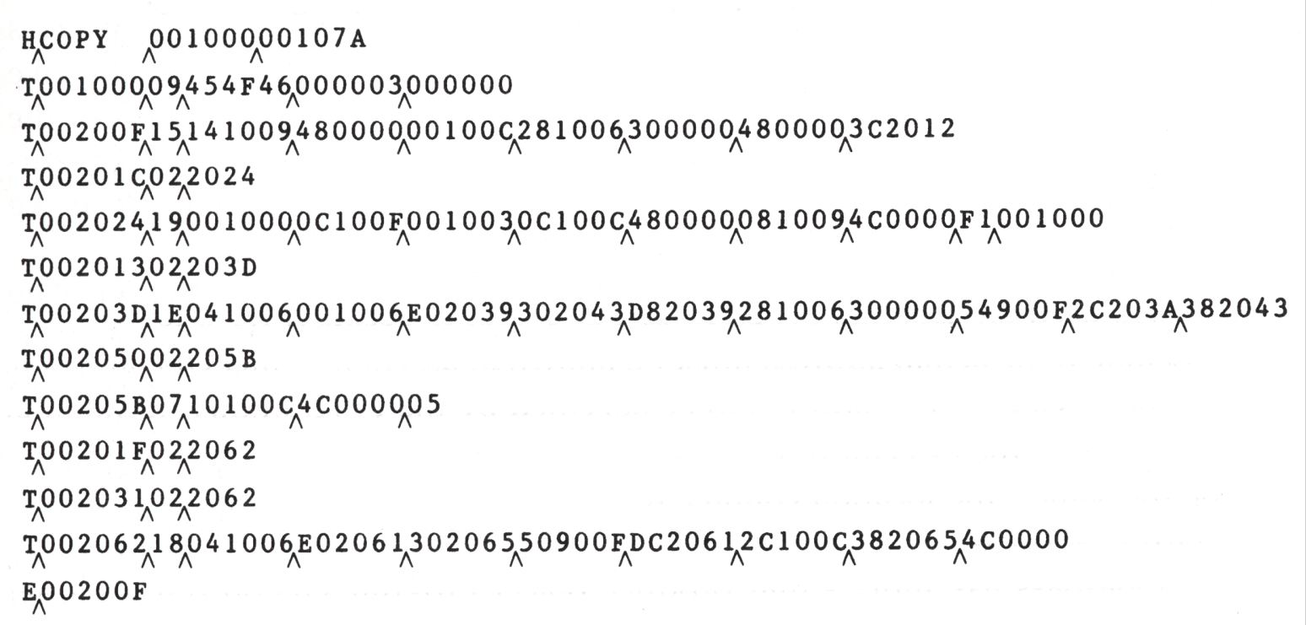
Object Program from One-Pass Assembler

Slide 15
Second text record contains object code generated from lines 10 through 40.
The operand addresses for the instructions on lines 15,30 and 35 are set to 0000.
When the definition of ENDFIL on line 45 is encountered, assembler generates a 3rd text record.
This text record specify that value 2024 is to be loaded at location 201C.
When the program is loaded, the value 2024 will replace the 0000 previously loaded.

Slide 16
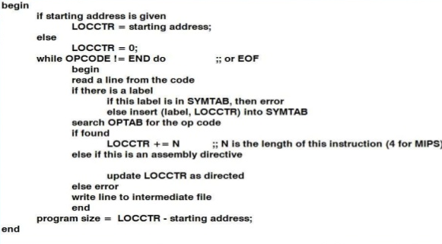
Algorithm for Single Pass Assembler

Slide 17
Multi-Pass Assembler
If we use a two-pass assembler, the following symbol definition cannot be allowed.
ALPHA EQU BETA
BETA EQU DELTA
DELTA RESW 1
This is because ALPHA and BETA cannot be defined in pass 1. Actually, if we allow multi-pass processing, DELTA is defined in pass 1, BETA is defined in pass 2, and ALPHA is defined in pass 3, and the above definitions can be allowed.
This is the motivation for using a multi-pass assembler.

Slide 18
Multi-Pass Assembler(cont’d)
It is unnecessary for a multi-pass assembler to make more than two passes over the entire program.
Instead, only the parts of the program involving forward references need to be processed in multiple passes.
The method presented here can be used to process any kind of forward references.

Slide 19
Multi-Pass Assembler Implementation
Use a symbol table to store symbols that are not totally defined yet.
For a undefined symbol, in its entry,
  We store the names and the number of undefined symbols which contribute to the calculation of its value.
  We also keep a list of symbols whose values depend on the defined value of this symbol.
When a symbol becomes defined, we use its value to reevaluate the values of all of the symbols that are kept in this list.
The above step is performed recursively.

Slide 20
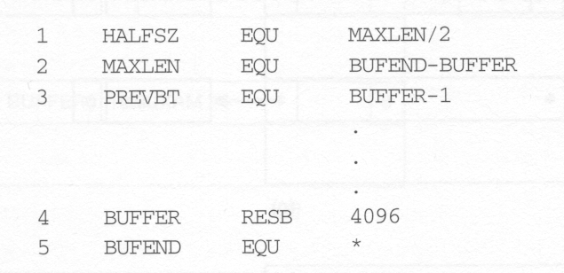
Forward Reference Example

Slide 21
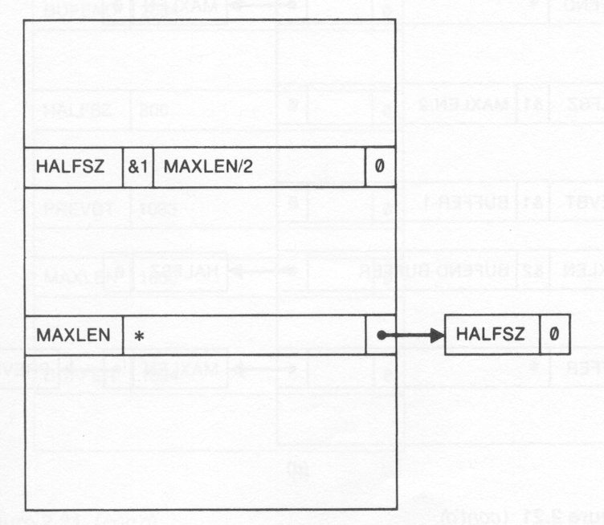
Forward Reference Processing
But one symbol is unknown yet
Defining expression for HALFSZ is stored in ST in place of its value
Defined
Not defined yet
After first line

Slide 22
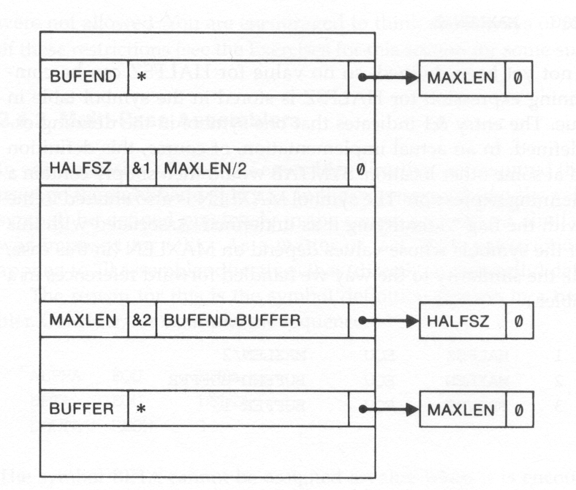
After second line
But two symbols are unknown yet
Now defined

Slide 23
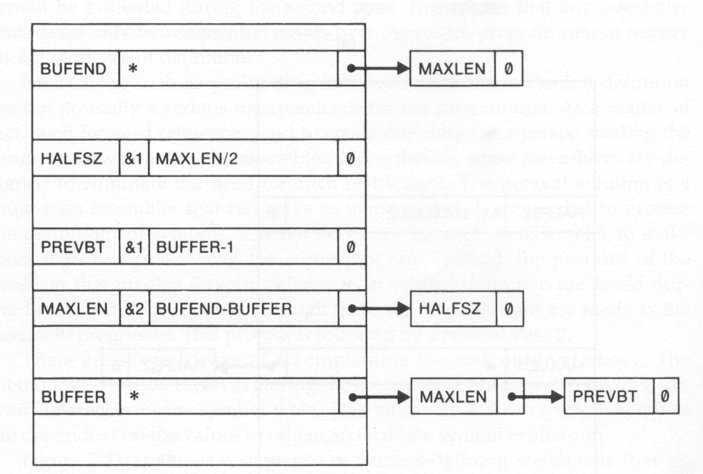
After third line

Slide 24
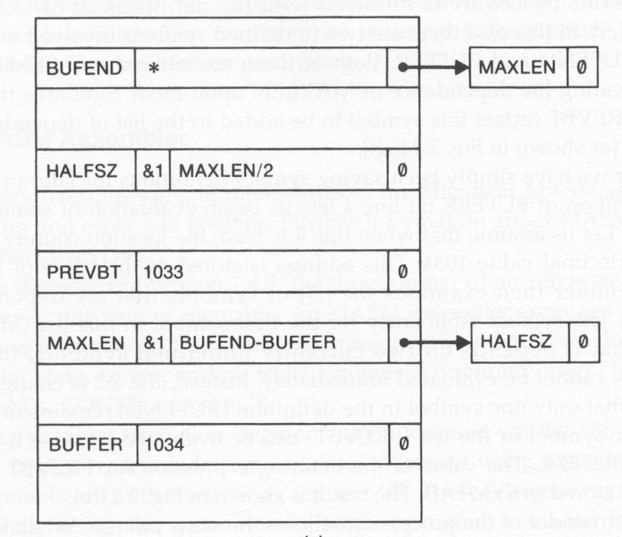
After 4’th line
Assume when 4th line is read, LOCCTR = 1034
=> BUFFER gets the value 1034
Start knowing values

Slide 25
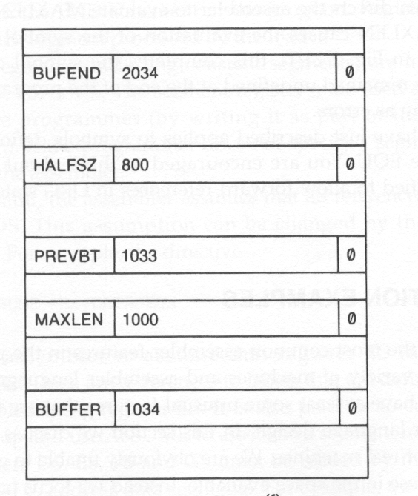
Start knowing values
After 5’th line
BUFEND
= (1034)16 + (4096)10
= (2034)16
All symbols are
defined and their
values are known
now.

Slide 26
MASM Assembler
Used with Pentium and other x86 systems.
Programmer of an x86 system views memory as a collection of segments.
MASM program is written as a collection of segments.
Each segment belong to a Class based on its contents.
Common classes are: CODE, DATA, CONST and STACK.

Slide 27
MASM Assembler
During program execution, segments are addressed via. the x86 segment registers.
Code segments are addressed using register CS.
Stack segments are addressed using register SS.
Segment registers are set by the system loader when the program is loaded for execution.
Register CS is set to indicate the segment that contains the starting label of the program.
Register SS is set to indicate the last stack segment processed by the loader.

Slide 28
MASM Assembler
Data Segments are addressed using DS, ES, FS or GS.
By default, the assembles assumes that all references to data segments use register DS.
This can be changed using assembler directive ASSUME.
eg:- ASSUME ES:DATASEG2
Assembler assumes that register ES indicates the segment DATASEG2. Any reference to labels defined in DATASEG2 will be assembled using register ES.

Slide 29
MASM Assembler
Jump instructions are assembled in two ways.
If the target of the jump is in the same code segment as the jump instruction - near jump.
Jump to a target in a different code segment - far jump.
near jump is assembled using current code segment register CS.
far jump is assembled using a different segment register.
Assembled machine instruction of a near jump occupies 2 or 3 bytes.
Assembled instruction of a far jump requires 5 bytes.

Slide 30
MASM Assembler
Forward reference
JMP TARGET
- If TARGET is defined before JMP, assembler knows - a near jump or far jump.
-By default, MASM assume that a forward jump is a near jump.
If the TARGET is in another code segment,
JMP FAR PTR TARGET

Slide 31
If the jump instruction is within 128-bytes of the current instruction, the programmer can specify a shorter near jump:
JMP SHORT TARGET
If the JMP to TARGET is a far jump, and the programmer does not specify FAR PTR, the assembler reserves 3 bytes, but the actual assembled instruction requires 5 bytes.

Slide 32
Length of an assembled instruction depends on the operands used.
  eg:- Operands of an ADD instruction may be registers, memory locations or immediate operands.
Immediate operands occupy 1-4 bytes in the instruction.
A memory location operand may take varying amount of space, depending upon the location of the operand.
ie. Pass1 of an x86 assembler is more complex than pass1 of SIC assembler.
Pass1 must analyze the operands, in addition to looking at the opcode.

Slide 33
Segments in an MASM program can be written in more than one part.
If a s SEGMENT directive specifies the same name as a previously defined segment, it is a continuation of that segment.

Slide 34
References between segments that are assembled together are handled by the assembler.
External references between separately assembled modules are handled by the linker.
The MASM directive PUBLIC has the same function as the SIC/XE directive EXTDEF.
The MASM directive EXTRN has the same function as EXTREF.

